Slide 1
Unsupervised Curricula for Visual Meta-Reinforcement Learning
Allan Jabri, Kyle Hsu, Ben Eysenbach, Abhishek Gupta, Sergey Levine, Chelsea Finn
NeurIPS 2019

Slide 2
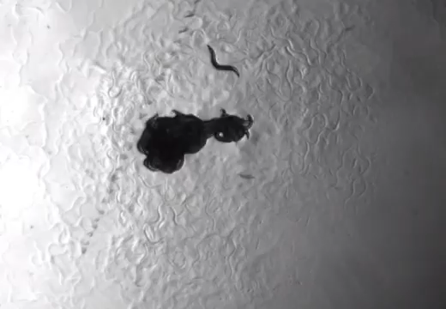
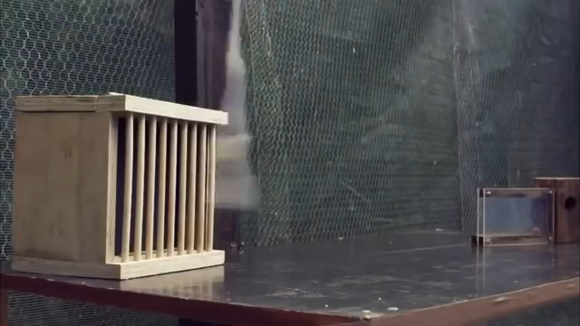
A Need to Generalize
C elegans
C. Elegans, foraging
New Caledonian Crow
applying tools
Notes:
The environments of our world are dynamic and changing.
Even simple animals like the c elegans have evolved to adapt foraging strategies to varying scenarios.
Smarter species like the New Caledonian crow even develop tools in order to generalize to new problems

Slide 3
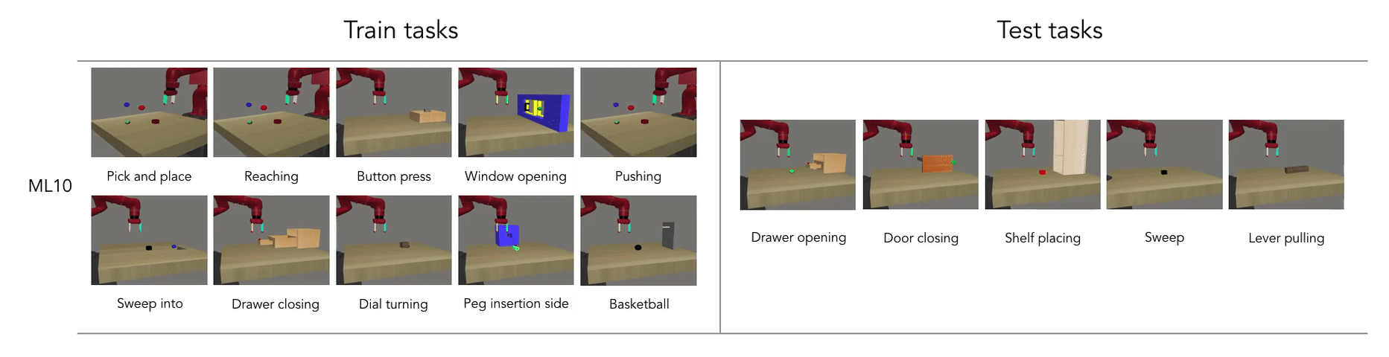
From Specialist to Generalist
Source: Meta-World
meta-world.github.io
Notes:
In RL, we’ve managed to build specialists that solve certain tasks very well.
We want to efficiently build systems that generalize
Transfer of function
Requirement of less direct supervision
Multi-task learning
Meta-learning
Continual learning
Unsupervised learning
…

Slide 4
Multi-task Reinforcement Learning
Contextual Policies
Task description is given
e.g. a goal
Meta-learning for RL
Task inferred from data collected by policy
more general

Slide 5
Meta-Reinforcement-Learning
Recurrent policy learns to infer task by collecting the right data
Notes:
Note: See each task multiple times, consecutively

Slide 6
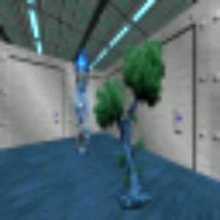

Visual Meta-Reinforcement-Learning
Search for and associate stimulus and reward.
Notes:
Note: See each task multiple times, consecutively

Slide 7
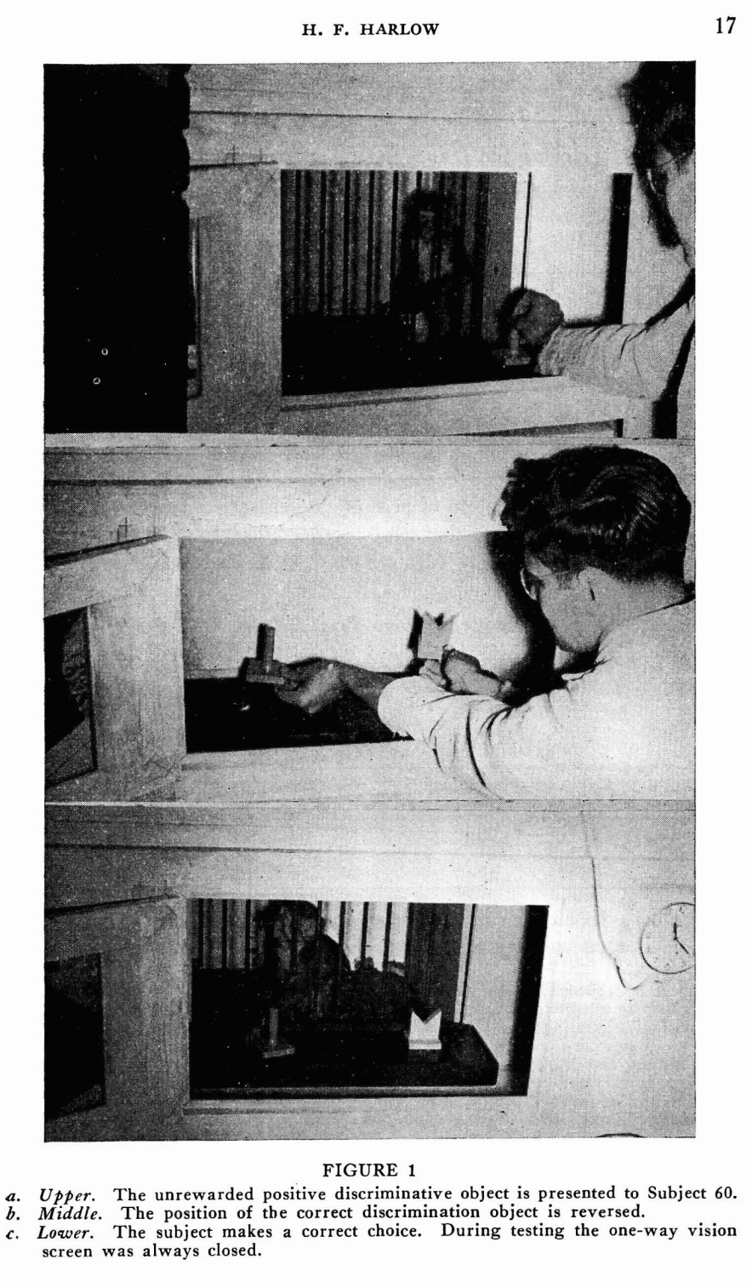
Meta-RL from Pixels
The formation of learning sets. 1949

Slide 8
The Task Distribution
Meta-training tasks give rise to
task inference and execution strategies
Notes:
–> extent of potential transfer
–> tedious to enumerate, tricky to design

Slide 9
Can we learn useful meta-RL strategies with tasks formed without supervision?

Slide 10
“Meta-Pre-training”
learned model providing
reward functions for meta-learning

Slide 11
Goal: Prepare a visuomotor agent with useful RL strategies by pre-training with self-generated tasks.

Slide 12
“Meta-Pre-training”
Unsupervised Pre-training
Transfer to Test Tasks

Slide 13
Tasks
Task Acquisition
Unsupervised discovery of tasks
Meta-learning
Learn to learn to solve tasks
Notes:
Prior work: Treat separately, from ground-truth low-dim state
CHALLENGE: JOINT OPTIMIZATION

Slide 14
Tasks
Task Acquisition
Unsupervised discovery of tasks
Meta-learning
Learn to learn to solve tasks
Data?
Should co-adapt
Notes:
Goal: Prepare a visuomotor agent with useful RL strategies by pre-training with self-generated tasks.
Prior work: Treat separately, from ground-truth low-dim state
CHALLENGE: JOINT OPTIMIZATION

Slide 15
Criteria for Task Distribution
Diversity
Structure
Notes:
The point is to prepare for generalization.
Here, we show the space of trajectories and

Slide 16
Criteria for Task Distribution
Diversity
Structure
Notes:
The point is to prepare for generalization.
Here, we show the space of trajectories and

Slide 17
Formulation
Policy
Post-update trajectories
Task scaffold
Task latent variable

Slide 18
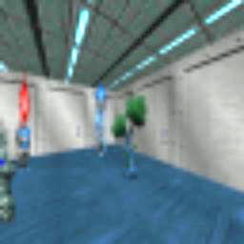
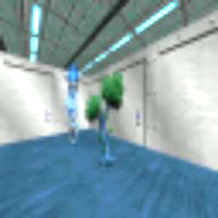
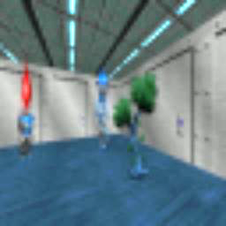
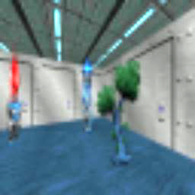
Data
+
1. Organize
2. Meta-Train
+
Update task scaffold
+
Update policy
Tasks

Slide 19
Data
+
1. Organize
2. Meta-Train
+
Update task scaffold
+
Update policy
Tasks
E-step
M-step

Slide 20
Task Acquisition (E-step)
Trajectory-level discriminative clustering

Slide 21
Task Acquisition (E-step)
Trajectory-level discriminative clustering
Conditional independence assumption

Slide 22
Meta-train (M-step)
Policy learns updated task distribution
+
i.e.
+
+

Slide 23
Meta-train (M-step)
Policy learns updated task distribution
+
i.e.
+
+
Density-based Exploration

Slide 24
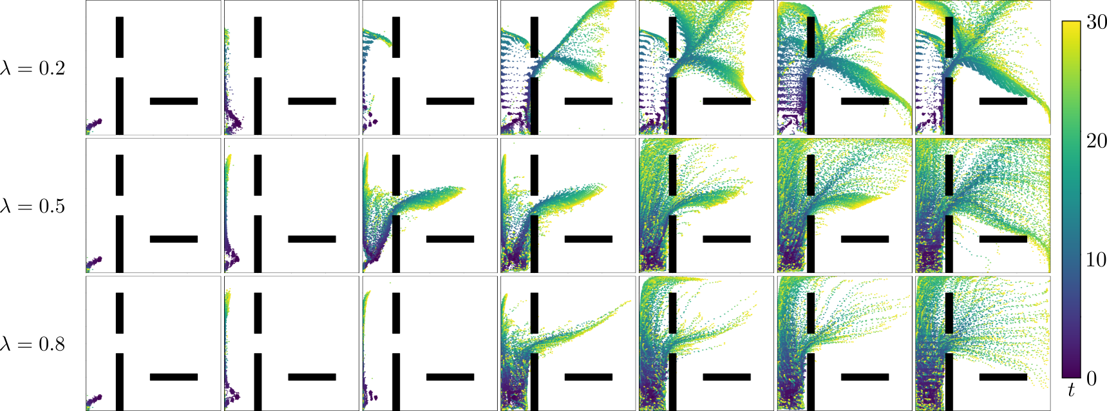
Effect of
Structure v. Diversity

Slide 25
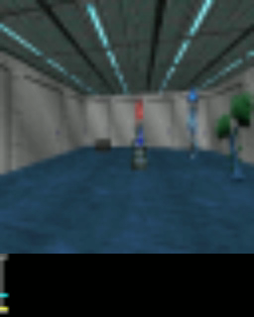
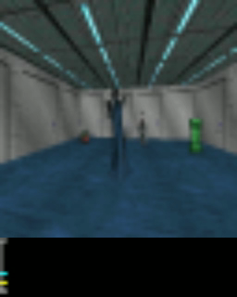
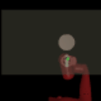
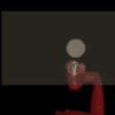
Experimental Setting
Visual Navigation
in VizDoom
Object Pushing
with Sawyer in MuJoCo

Slide 26

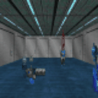
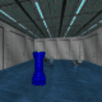

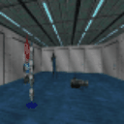

What kind of tasks are discovered?
Direction encoded as color

Slide 27
What kind of tasks are discovered?
Start
Direction encoded as color

Slide 28




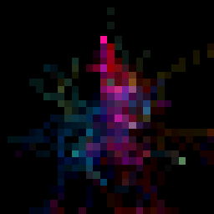








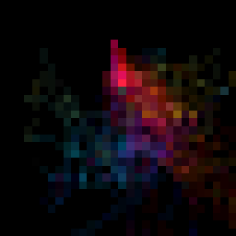




What kind of tasks are discovered?
Step 1
Step 5

Slide 29

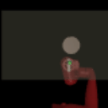
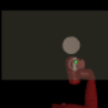
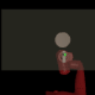
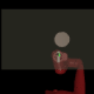
What kind of tasks are discovered?

Slide 30
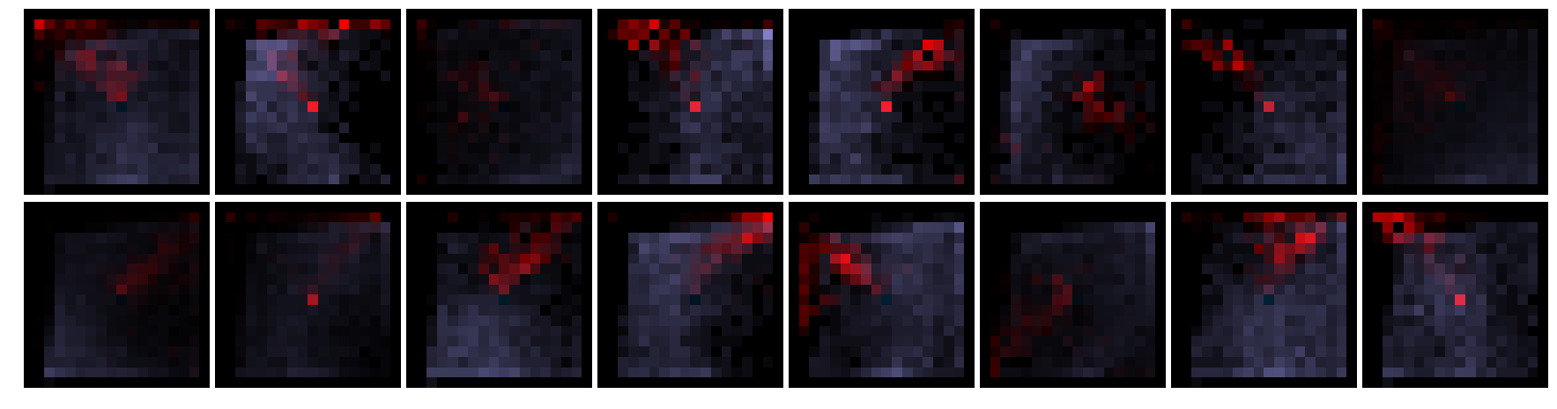
What kind of tasks are discovered?

Slide 31
Transfer to Test Tasks – VizDoom
Direct Transfer
Notes:
Do these tasks allow for meta-training of strategies that transfer to test tasks?

Slide 32
Transfer to Test Tasks – VizDoom
Faster
Finetuning
Notes:
Do these tasks allow for meta-training of strategies that transfer to test tasks?

Slide 33
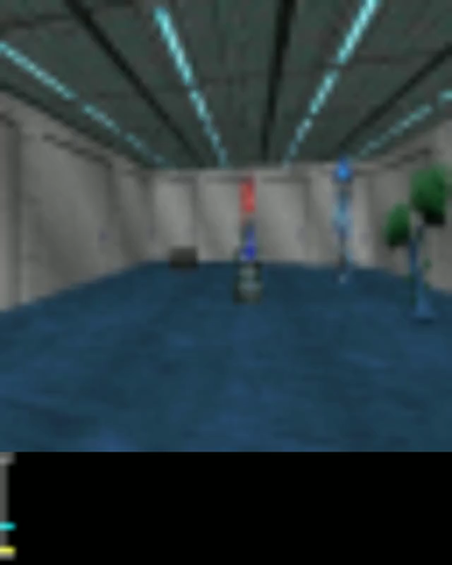
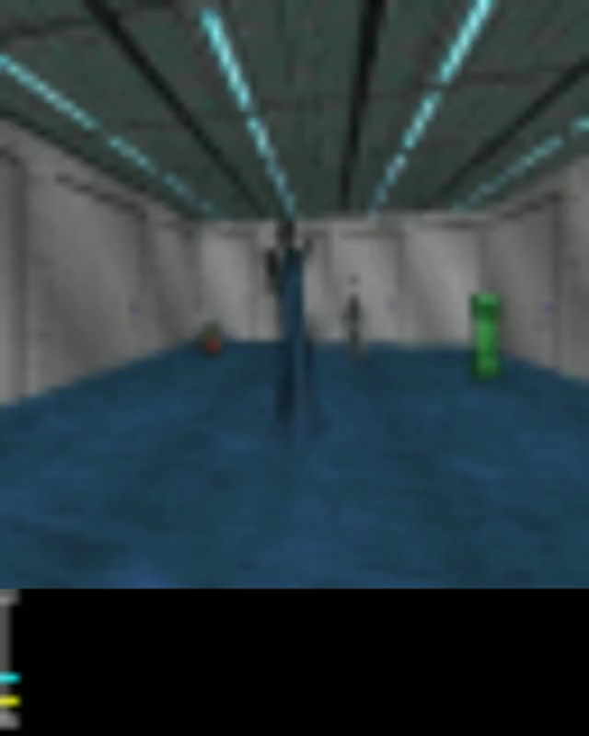

Transfer to Test Tasks – VizDoom
Reward
Episode boundary

Slide 34
Transfer to Test Tasks – Sawyer
Direct Transfer
Notes:
Do these tasks allow for meta-training of strategies that transfer to test tasks?

Slide 35
Transfer to Test Tasks – Sawyer
Faster
Finetuning
Notes:
Do these tasks allow for meta-training of strategies that transfer to test tasks?

Slide 36
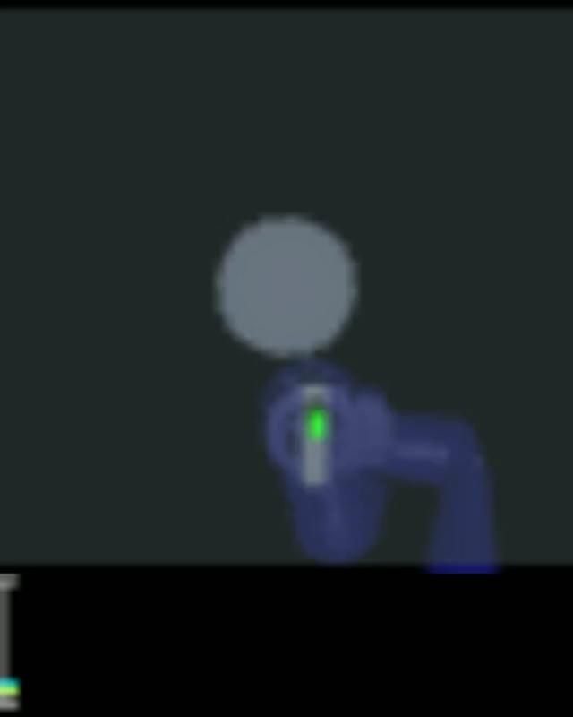

Transfer to Test Tasks – Sawyer
Reward
Episode boundary

Slide 37
Variants
Notes:
We also compare to variants of our method, that use different task acquisition procedures.

Slide 38
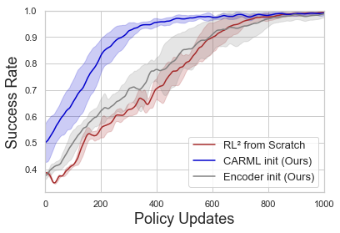
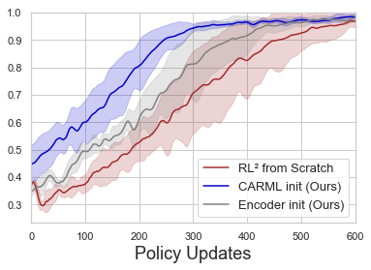
Faster Supervised Meta-RL

Slide 39
Thank You
Kyle Hsu
Ben Eysenbach
Abhishek Gupta
Sergey Levine
Chelsea Finn
Poster #35, East Exhibition Hall B + C
https://sites.google.com/view/carml

